Slide 1

Road Management System
Ibrahim Abou Zahr – Mohamad Abdel Rahman – Ali Yaman – Yehya Fleifel

Slide 2
Project idea and goals (1)
What is the purpose of our software?
Ensures city hall policies are being enforced via reports from residents.
Establishes a strong connection between the municipality and the community.
Prioritizes safety and cleanliness in the neighborhood.
Fosters cooperation between district managers and locals to address street related issues.

Slide 3
Project idea and goals (2)
What are the problems being tackled?
Common problems of street ignorance, notably sinkholes acting as accident risks.
Thrown garbage on sidewalks causing environmental health problems.
Broken street lights which is a dangerous hazard requiring immediate reporting.
Lack of manhole covers due to theft and vandalism.

Slide 4
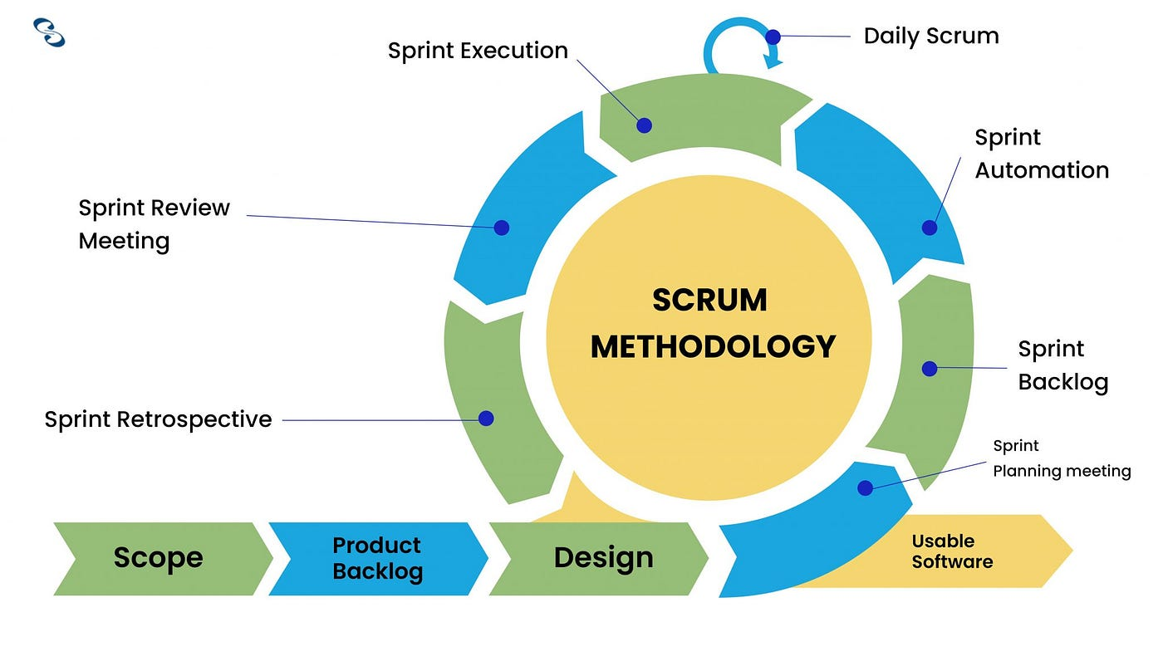
Sdlc Model Used
Why use scrum?
Flexible and adaptive
Continuous improvement.
Iterative and Incremental (Sprints).
Self-organizing teaming.
Frequent releases.
Emphasis on customer collaboration.

Slide 5
Project Organization
During our research for exploring the best software development environment , we came along interesting paths for ClickUp , Trello, Microsoft – To Do and Jira.
- Why Trello?
It offers a user-friendly interface, flexible structure, collaboration features, integration options, and mobile accessibility.
Why Jira?
It supports agile methodologies like Scrum and Kanban, offers customizable workflows, and integrates with popular tools.

Slide 6
Project Organization (2)
Why Microsoft To Do?
It features a simple, intuitive interface, task organization features, collaboration, and offline access.
Why ClickUp?
It features a simple, intuitive interface, task organization features, collaboration, and offline access.
Overall, each platform offers unique benefits, from ClickUp's comprehensive task management capabilities to Jira's advanced support for agile methodologies.
Hence, Jira software has been selected due to its efficient organization of teamwork, robust analytics capabilities, effective sprint planning and backlog management.

Slide 7
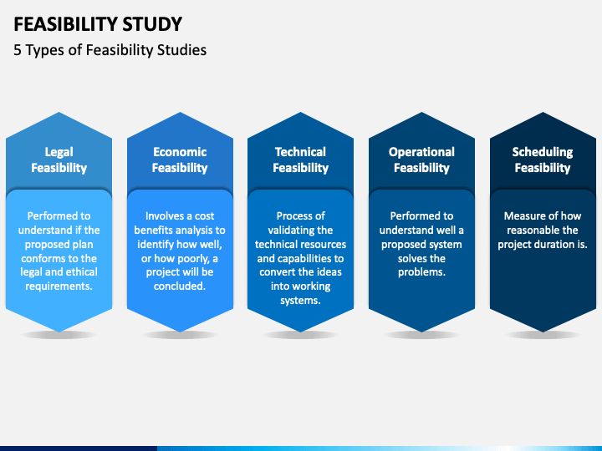
Feasibility Study
Is our software Legally Feasible?
Yes, it is legally doable.
Is our software Technically Feasible?
Yes, it uses modern age tech without complicating things especially in Lebanon.
Is our software Economically Feasible?
Lets check the numbers!

Slide 8
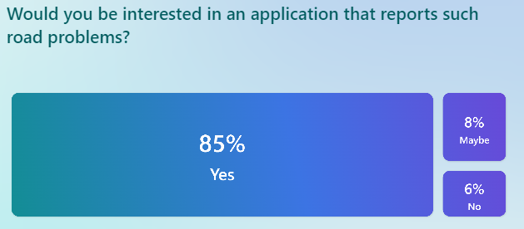
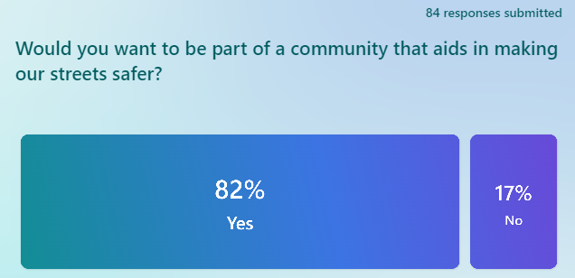
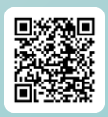
Survey(84 responses)
Above statistics also indicate that our project is also market feasible!

Slide 9
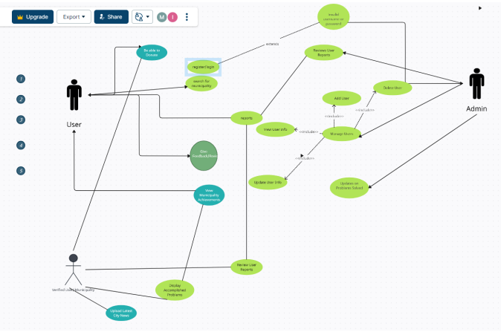
Use case diagram
Link : https://app.creately.com/d/DI0ZsIYsijt/edit

Slide 10
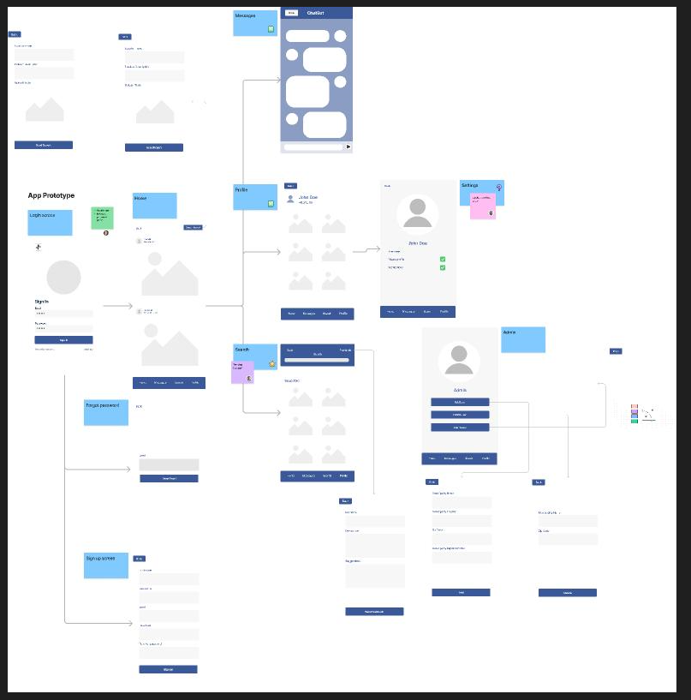
Design Scheme
https://www.figma.com/file/pEabKvfTPbD6dpeAzgNWua/Untitled?type=whiteboard&node-id=0-1

Slide 11
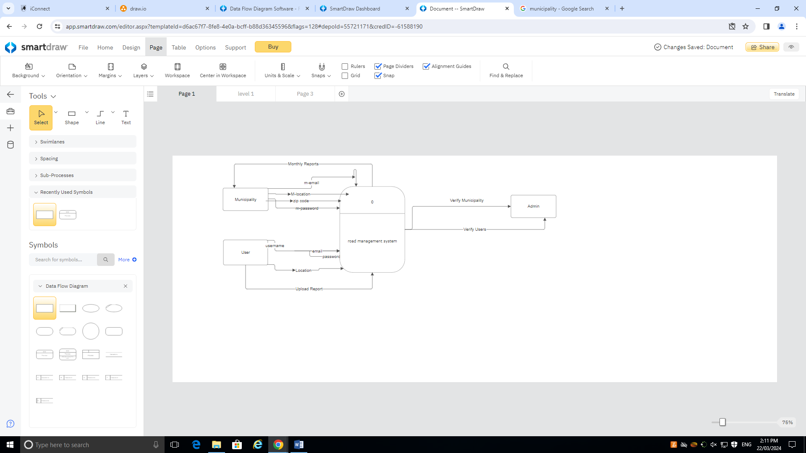
Data flow diagram Level0

Slide 12
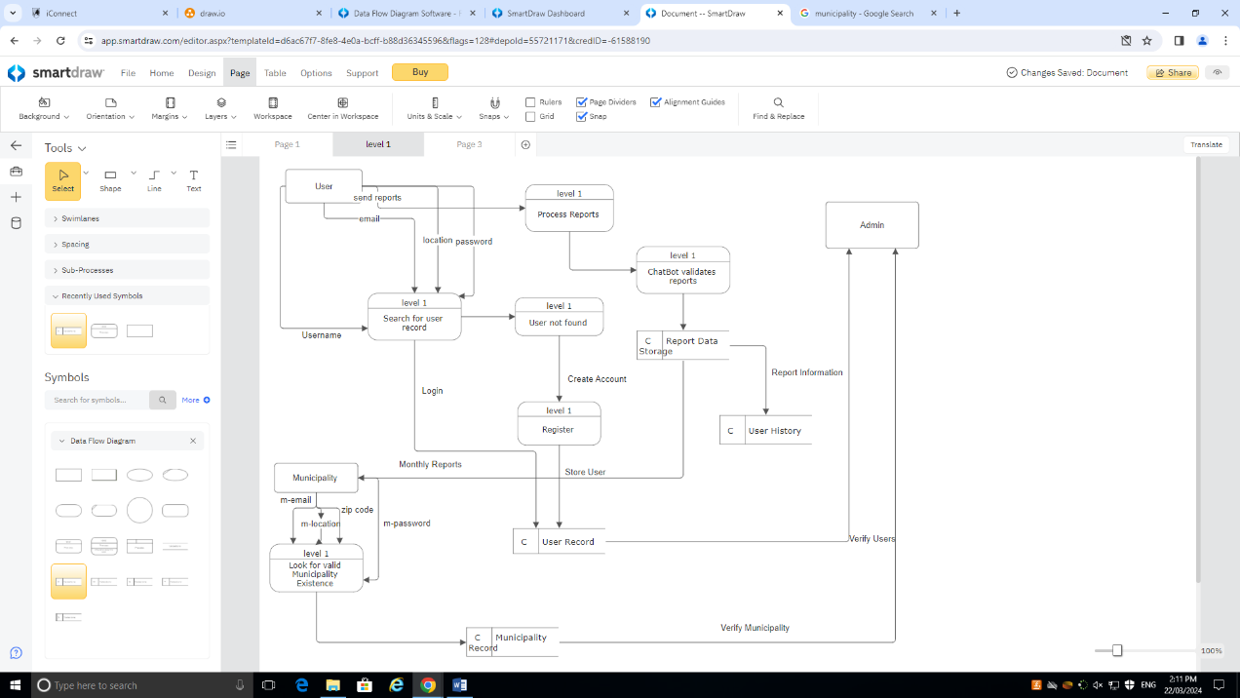
Data flow diagram Level 1

Slide 13
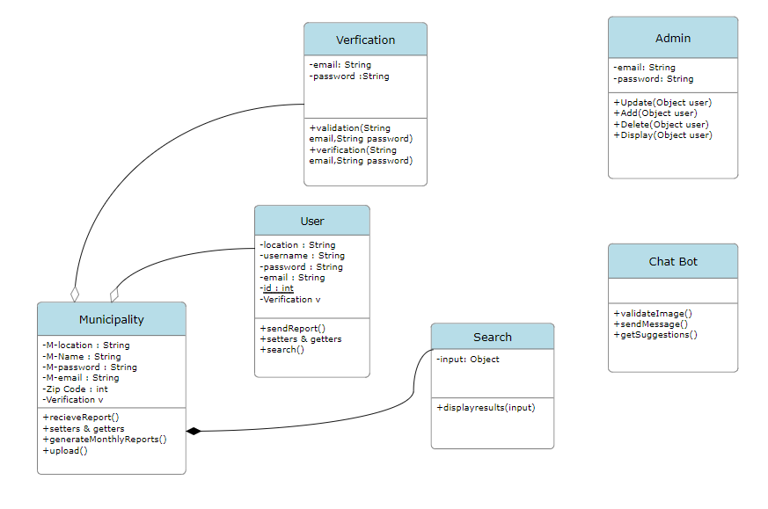
Structural UML Diagram

Slide 14
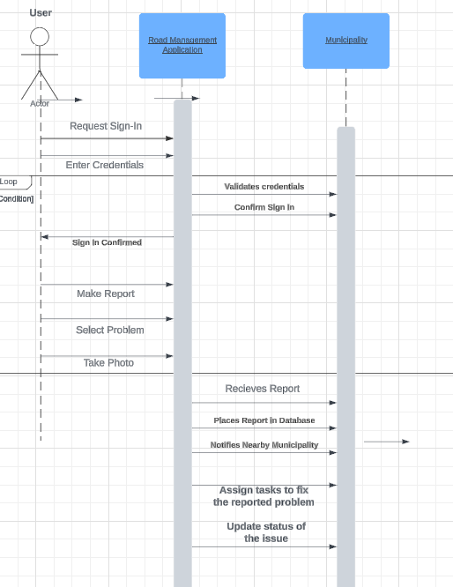
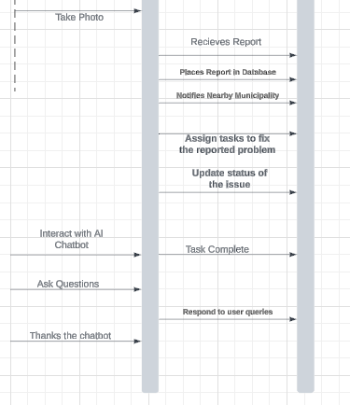
Sequence Diagram
First Part:
Second Part:

Slide 15
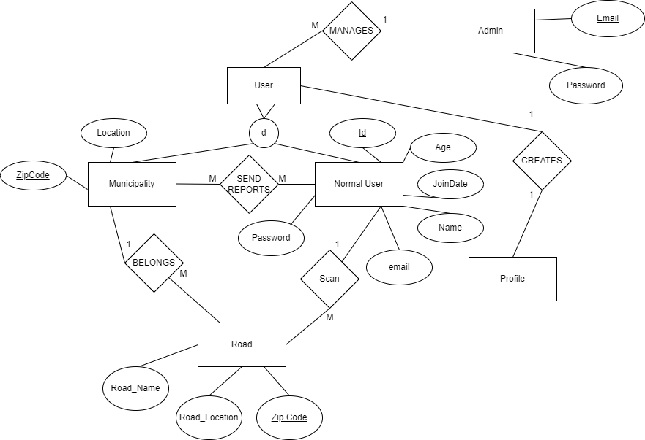
Extended ER MODEL

Slide 16
Stack used
Front-end: Flutter & Dart (framework of Flutter)
Back-end: Python, Django (framework of Python)
Database: MongoDB
Real-time functionality: Firebase Real-time Database
Google maps API

Slide 17


Why flutter & dart?
Cost efficiency
Faster app development
Short time-to-market
Create cross-platform apps that provide native performance
Easy to learn

Slide 18


Why python with Django?
Robustness
Scalability
Ease of use
Contains many libraries
Fast Processing
Secure

Slide 19

Database
MongoDB:
Powerful querying and analytics
Handles highly diverse data types
NoSQL, because we do not want to use a relational database.
Great for big data systems
Full technical support and documentation

Slide 20

Api Used
Why Google Maps API?
Embed interactive maps into websites
Allow users to explore different locations
Enable zoom in and out functionality
Toggle between map types
Interact with markers and overlays on the map

Slide 21

Firebase real-time database
Firebase allows secure access to the database from client-side code
It ensures only authorized users can interact with the database
Firebase keeps data synchronized in real-time
This helps in building collaborative apps with ease

Slide 22
Thank you!
Looking forward to see you support our project!

